Slide 1
Module 5
Deadlocks Protection

Slide 2
Deadlock characterization
A process in operating system uses resources in the following way.
Requests a resource
Use the resource
Releases the resource

Slide 3
Deadlock
Deadlock is a situation where a set of processes are blocked because each process is holding a resource and waiting for another resource acquired by some other process.
Consider an example when two trains are coming toward each other on the same track and there is only one track, none of the trains can move once they are in front of each other.
A similar situation occurs in operating systems when there are two or more processes that hold some resources and wait for resources held by other(s).
For example, in the below diagram, Process 1 is holding Resource 1 and waiting for resource 2 which is acquired by process 2, and process 2 is waiting for resource 1.

Slide 4
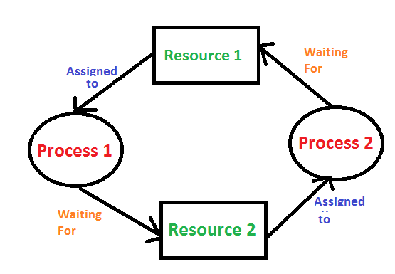

Slide 5

Deadlock can arise if the following four conditions hold simultaneously (Necessary Conditions)
Mutual Exclusion: Two or more resources are non-shareable (Only one process can use at a time)

Slide 6
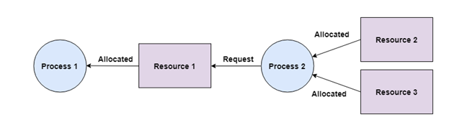
Hold and Wait:
A process can hold multiple resources and still request more resources from other processes which are holding them.
In the diagram given below, Process 2 holds Resource 2 and Resource 3 and is requesting the Resource 1 which is held by Process 1.

Slide 7
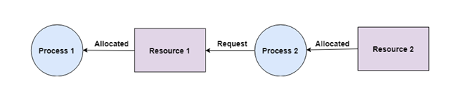
No Preemption:
A resource cannot be preempted from a process by force. A process can only release a resource voluntarily.
In the diagram below, Process 2 cannot preempt Resource 1 from Process 1.
It will only be released when Process 1 relinquishes it voluntarily after its execution is complete.

Slide 8
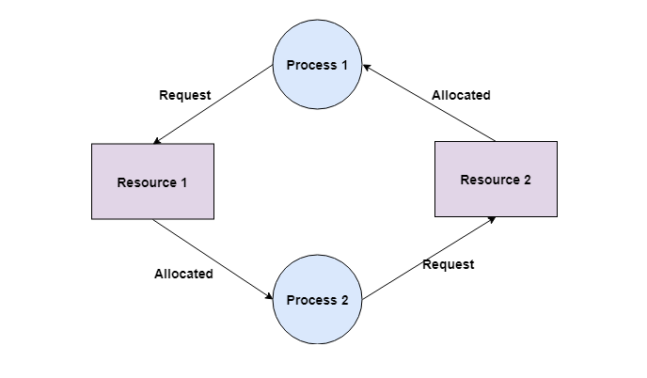
Circular Wait:
A process is waiting for the resource held by the second process, which is waiting for the resource held by the third process and so on, till the last process is waiting for a resource held by the first process. This forms a circular chain.
For example: Process 1 is allocated Resource2 and it is requesting Resource 1. Similarly, Process 2 is allocated Resource 1 and it is requesting Resource 2. This forms a circular wait loop.

